Slide 1

Prim’s algorithm
CLRS Chapter 23.2

Slide 2
Prim’s Algorithm Outline
An example of our generic MST algorithm
Proceeds by repeatedly picking safe edges
Starts from a vertex s, edges in A form a tree rooted at s
During each iteration, a safe edge is added to A: minimum weight edge connecting the tree to some vertex outside the tree

Slide 3
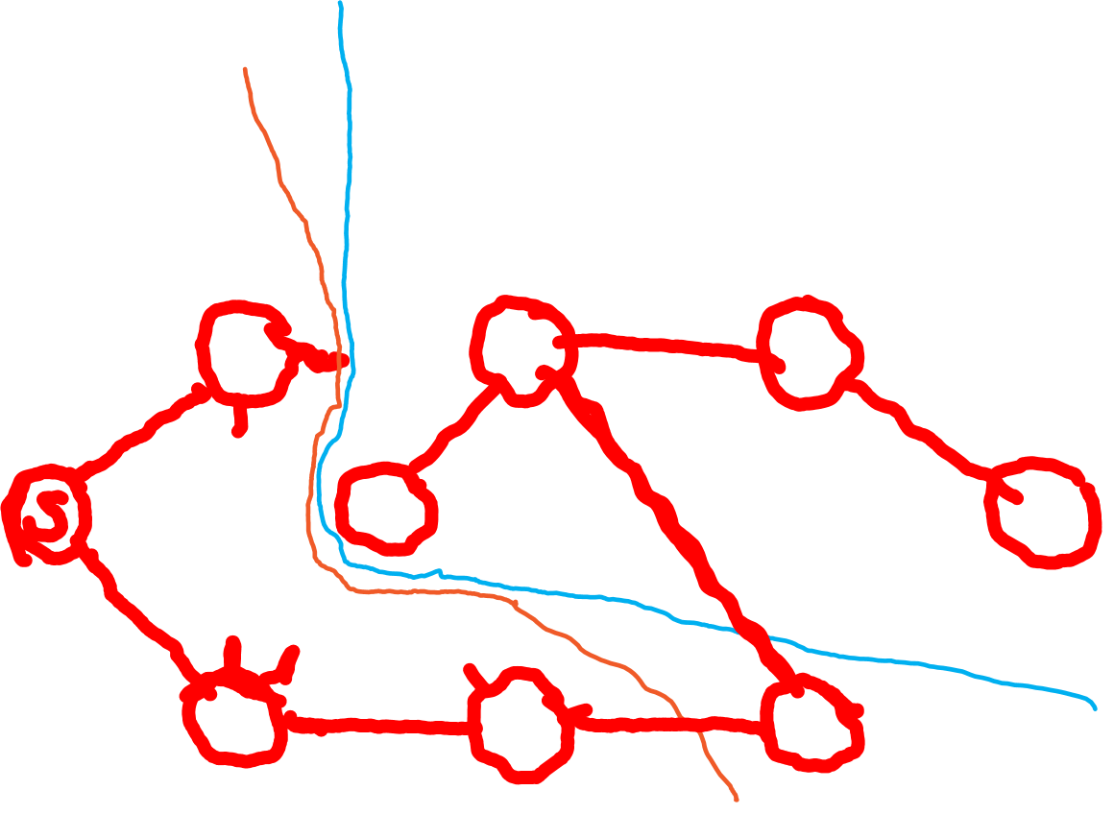
Prim’s Algorithm Example Run
8
7
4
9
2
11
14
4
10
8
7
6
1
2

Slide 4

Prim’s algorithm: pseudocode
MST-Prim(G,w,s)
For each vertex u of G
u.key = $∞$
u.$π$ = NIL
s.key = 0
Q= V
While Q$≠∅$
u = Extract-Min(Q)
For each neighbor v of u
If v $∈$ Q and w(u,v) < v.key
v.$π$ = u
v.key = w(u,v)

Slide 5
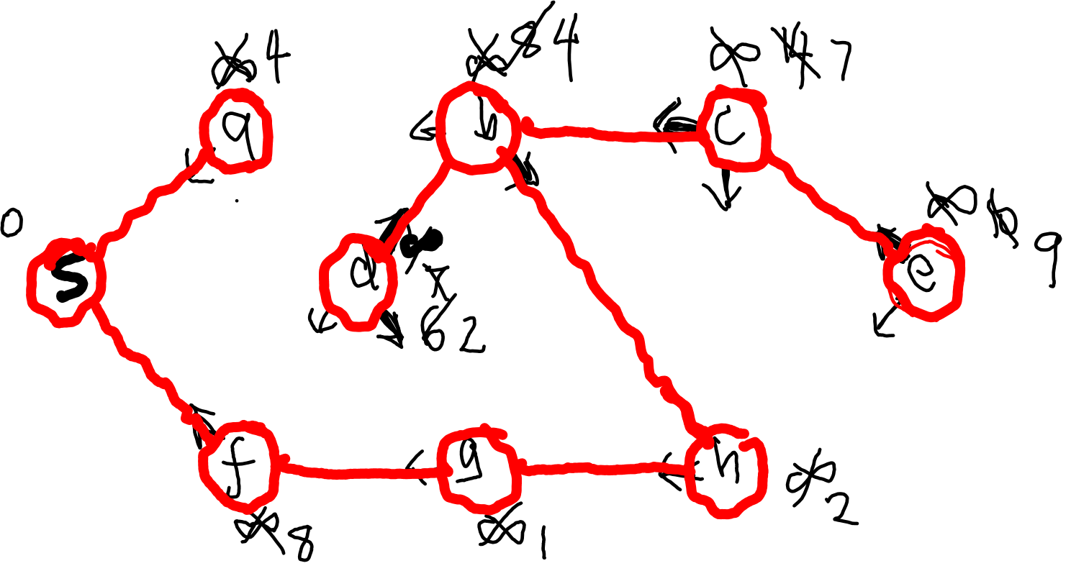
Prim’s algorithm: performance & example
Example:
8
7
4
9
2
11
14
4
10
8
7
6
1
2

Slide 6
Prim’s algorithm: Running time
Heap implementation: O(n) construction, O(log n) updates (decrease-key), O(log n) extract-min
Construct Q: O(n)
Extract min n times: O(n log n)
Decrease-key: m times O(m log n)
Total: O(m log n)

Slide 7

Prim’s algorithm: performance & example
Overall running time:
Uses: Build-Heap + O(V) Extract-Min + O(E) Decrease-Key
Overall $O\left(\left|V\right|\log\left|V\right|+\left|E\right|log⁡(|V|)\right)=O(|E|\log{|V|})$
Example:
8
7
4
2
9
14
4
10
8
7
6
1
2

